Slide 1
RFID BASED SECURITY AND AUTHENTICATION SYSTEM
Amit Shingankar
Atul Gaikwad
Rohan Kamthe

Slide 2
Contents:
Project overview
Block diagram
Power supply
Microcontroller
RFID
Relay
LCD
Software requirements
Schematic & Working of the project
Advantages
Applications
Future scope
Conclusion

Slide 3
The main objective of this project is to provide security in an organization by allowing authorized person to enter or to access the door to enter into the organization.
For this purpose the authorized persons are provided with an RFID Card
This card contains an integrated circuit that is used for storing, processing information, modulating and demodulating the radio frequency signal that is being transmitted.
Thus, once the person shows the RFID card to the RFID card reader it scans the data present on the card and compares it with that of the data present in the system and once it matches it displays the message saying valid and unlocks the door or else states invalid and doesn’t allow the access.

Slide 4
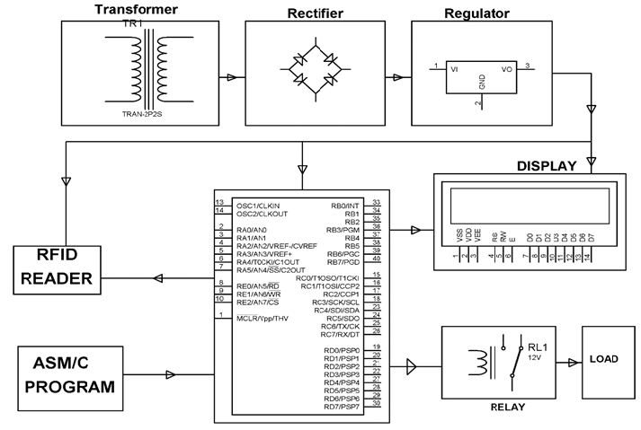
Block Diagram
PIC 18F series mc

Slide 5
Microcontroller(PIC18Fxxxx)
High-Performance RISC CPU.
Only 35 single-word instructions.
All single-cycle instructions except for program branches, which are two cycle.
Operating speed: DC – 20 MHz clock input DC – 200 ns instruction cycle.
Up to 8K x 14 words of Flash Program Memory, Up to 368 x 8 bytes of Data Memory (RAM), Up to 256 x 8 bytes of EEPROM Data Memory.
Pin out compatible to other 28-pin or 40/44-pin, PIC18CXXX and PIC18FXXX microcontrollers.

Slide 6
Special Microcontroller Features:
100,000 erase/write cycle Enhanced Flash program memory typical.
1,000,000 erase/write cycle Data EEPROM memory typical.
Data EEPROM Retention > 40 years.
Self-reprogrammable under software control.
In-Circuit Serial Programming™ (ICSP™) via two pins.
Single-supply 5V In-Circuit Serial Programming.
Watchdog Timer (WDT) with its own on-chip RC oscillator for reliable operation.
Programmable code protection.
Power saving Sleep mode.
Selectable oscillator options.
In-Circuit Debug (ICD) via two pins.

Slide 7
Peripheral Features:
Timer0: 8-bit timer/counter with 8-bit prescaler.
Timer1: 16-bit timer/counter with prescaler, can be incremented during Sleep via external crystal/clock.
Timer2: 8-bit timer/counter with 8-bit period register, prescaler and postscaler.
Two Capture, Compare, PWM modules
- Capture is 16-bit, max. resolution is 12.5 ns
- Compare is 16-bit, max. resolution is 200 ns
- PWM max resolution is 10-bit
Synchronous Serial Port (SSP) with SPI™ (Master mode) and I2C™ (Master/Slave).
Universal Synchronous Asynchronous Receiver Transmitter (USART/SCI) with 9-bit address detection.
Parallel Slave Port (PSP) – 8 bits wide with external RD, WR and CS controls (40/44-pin only).
Brown-out detection circuitry for Brown-out Reset (BOR).

Slide 8
Pin description OF PIC18Fxxx:

Slide 9
What is RFID?
Radio-frequency identification (RFID) is an automatic identification method, relying on storing and remotely retrieving data using devices called RFID tags or transponders.
RFID (radio frequency identification) is a technology that incorporates the use of electromagnetic or electrostatic coupling in the radio frequency (RF) portion of the electromagnetic spectrum to uniquely identify an object, animal, or person.
An alternative to bar code.
RFID is also called dedicated short range communication(DSRC)

Slide 11
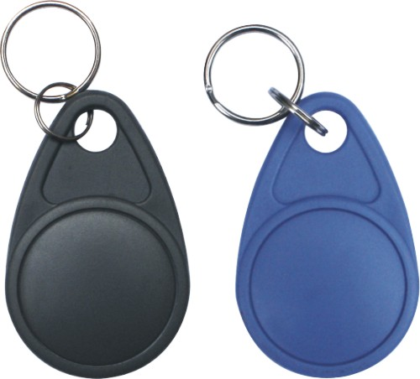
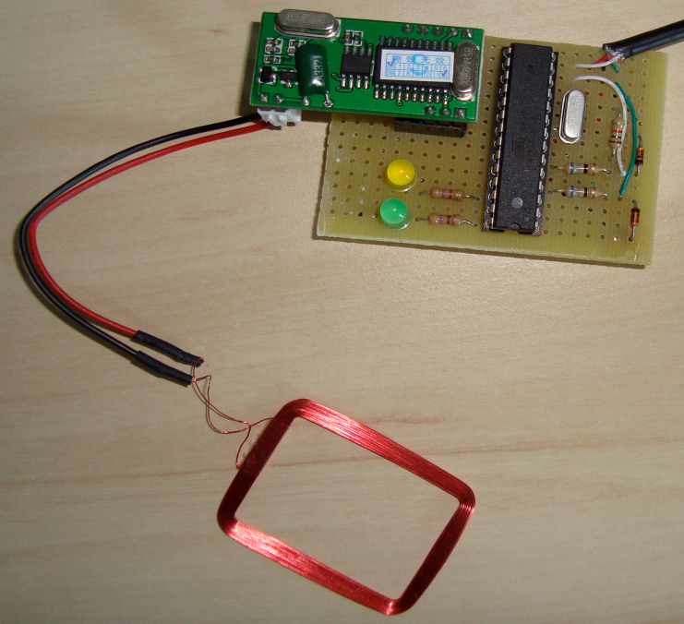
Contd..
RFID Benefits Versus Bar Code Labels and Scanning
Eliminates human error
Improves speed and efficiency
Increases information availability and location
Allows enhanced security
Delivers data with or without network connection
RFID Application
Manufacturing
Supply Chain, Logistics & Distribution
Security And Access Control
Parking, Bay And Terminal Management
Tool Collection

Slide 12

relay
A relay is an electrically operated switch.
Current flowing through the coil of the relay creates a magnetic field which attracts a lever and changes the switch contacts.
The coil current can be on or off so relays have two switch positions and have double throw (changeover) switch contacts as shown in the diagram.
Relays allow one circuit to switch a second circuit which can be completely separate from the first.
For example a low voltage battery circuit can use a relay to switch a 230V AC mains circuit.
There is no electrical connection inside the relay between the two circuits, the link is magnetic and mechanical.

Slide 13
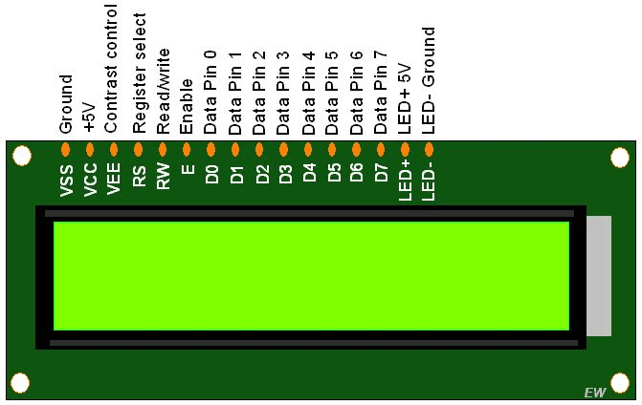
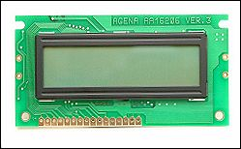
Liquid crystal display-LCD:
Most common LCDs connected to the microcontrollers are 16x2 and 20x2 displays.
This means 16 characters per line by 2 lines and 20 characters per line by 2 lines, respectively.
The standard is referred to as HD44780U, which refers to the controller chip which receives data from an external source (and communicates directly with the LCD.

Slide 14
If an 8-bit data bus is used the LCD will require 11 data lines(3 control lines plus the 8 lines for the data bus)
The three control lines are referred to as EN, RS, and RW
EN=Enable (used to tell the LCD that you are sending it data)
RS=Register Select. When RS=0; data is treated as a command & When RS=1; data being sent is text data.
R/W=Read/Write . When RW=0; the data written to the LCD & When RW=0; the data reading to the LCD.

Slide 15
Working of project
The project uses a RFID reader that sends a 125 KHz signals while a RFID card is swiped over the same.
The card used gets powered by inductive means with the coil inside the same duely rectified and filtered for a DC voltage to drive the inbuilt chip in the card.
Thus while the card is swiped over sends a valid data to the MC to output a logic high from the MC at pin 16 to switch on transistor which finally actuates the load for example a lamp in this case.
The LCD display indicates all the position occruing in the process.

Slide 16
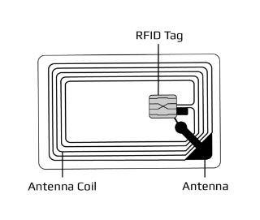
RFID:
Radio-frequency identification (RFID) is an automatic identification method, relying on storing and remotely retrieving data using devices called RFID tags or transponders.
RFID (radio frequency identification) is a technology that incorporates the use of electromagnetic or electrostatic coupling in the radio frequency (RF) portion of the electromagnetic spectrum to uniquely identify an object, animal, or person.
An alternative to bar code.
RFID is also called dedicated short range communication(DSRC)
Micro Chip

Slide 17
When user brought the RFID tag in range of RFID reader, then electromagnetic coupling takes place between RFID reader and RFID tag and the RFID tag gets energized.
The RFID reader reads information of RFID tag and send it to the microcontroller. After that microcontroller will check the information given by RFID reader and check it with the data stored in its memory
If the stored data matches with read data then it will send commands to display the message ACCESS GRANTED and gives High signal for actuating relay
If the stored data does not match with read data than it will send commands to display the message ACCESSS DENIED and relay remain unactuated.

Slide 18


Slide 19


